Slide 1
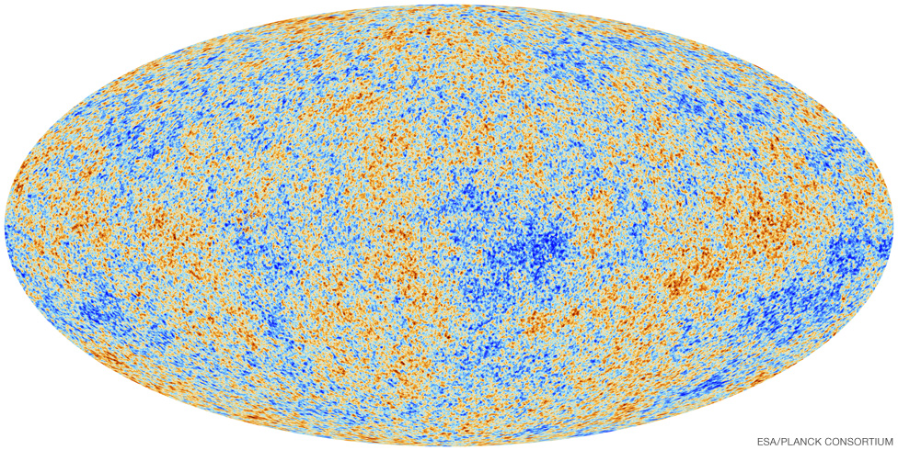
Intro to Cosmology!
OR
What is our Universe?

Slide 2
The Latest High Resolution Image of the Cosmic Microwave Background Radiation
High Energy Region
Low Energy Region
Corresponds to areas of low mass density
Corresponds to areas of high mass density

Slide 3
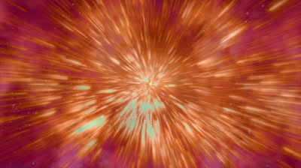
Why Is This Important?
The Big Bang!

Slide 4
The CMB was discovered in 1964. The Big Bang Theory was NOT the most popular theory in Cosmology at the time.
Despite all the fancy colors and swirls on the map, the CMB is actually very isotropic. Variations are on the order of 0.0002K.
CMB uniformity due to spread of free photons soon after the Big Bang, known as the photon decoupling epoch.

Slide 5
Photon Decoupling
Inflation

Slide 6
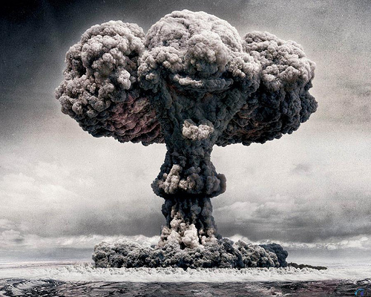
What Exactly Was The Big Bang?

Slide 7
Temporal Evolution of the Universe
Galactic Era: Present
Galaxies + Clusters
Atomic Era: 1 billion years
Atoms + First Stars
Nuclei Era: 380,000yrs
Hydrogen + Helium
Photon Decoupling
Nucleosynthesis Era: 3min
Protons + Neutrons
Particle Era: 0.001s
Constant Annihilation
Electroweak Era: 10⁻¹⁰s
Reheating
Inflationary Epoch
GUT Era: 10⁻³⁸s
Gravity Becomes Distinct
Planck Era: 10⁻⁴³s
???
Notes:
GUT Era speculatively contains weird things like magnetic monopoles.

Slide 8
Inflationary Theory
Rapid, short term spatial inflation
NOT space-time inflation.
Driven by a highly energized negative Higgs field.
Flatness of Space
Space-time is NOT flat, as predicted by general relativity
Local space is not flat
On a cosmic scale the inner angles of a triangle add up to 180º
Quantum Inflation

Slide 9
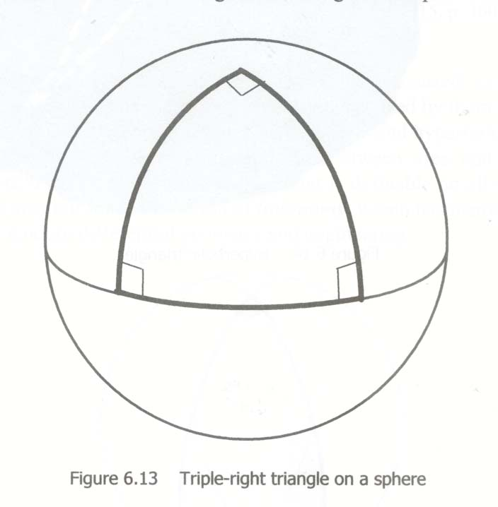
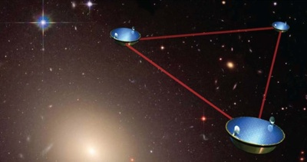
Flat Versus Curved Space

Slide 10
Quantum Fluctuations

Slide 11
Quantum Fluctuations
Quantum Inflation

Slide 12
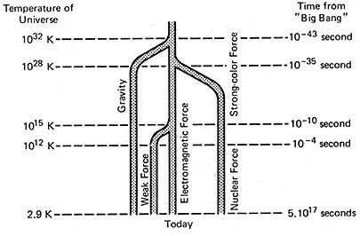
Electroweak Era
Existence of Electroweak recombination has been experimentally verified. Grand Unification Theory is predicted based on mathematical properties of carrier particles.

Slide 13
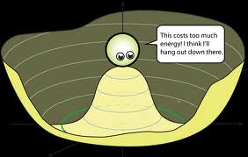
Electroweak Carrier Particles
W⁻
Z₁
Z₂
W⁺
Lower Energy
W + ϒ⁺
W + ϒ⁻

Slide 14
Temporal Evolution of the Universe
Galactic Era: Present
Galaxies + Clusters
Atomic Era: 1 billion years
Atoms + First Stars
Nuclei Era: 380,000yrs
Hydrogen + Helium
Photon Decoupling
Nucleosynthesis Era: 3min
Protons + Neutrons
Particle Era: 0.001s
Constant Annihilation
Electroweak Era: 10⁻¹⁰s
Reheating
Inflationary Epoch
GUT Era: 10⁻³⁸s
Gravity Becomes Distinct
Planck Era: 10⁻⁴³s
???
Notes:
GUT Era speculatively contains weird things like magnetic monopoles.

Slide 15
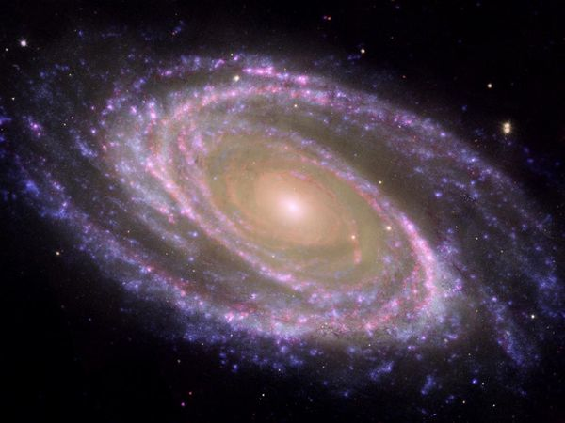
Problems in Modern Cosmology
Dark Matter: Current estimates of matter in galaxies does not account for galaxy motion.
Calculate rotational velocity at distances from center.
Calculations predict enormous ring of mass around the galaxy.
Dark Energy: Why is universal expansion accelerating?

Slide 16
Dark Matter
84.5% of the mass of the known universe. 26.8% of the total mass-energy.
Does not interact with electromagnetism.
Does not interact with light.
Does not contain charged particles.
Luminous Matter

Slide 17
Dark Matter
Massive analogue of Electroweak separation?
GUT
W⁺
W + ϒ⁺
L
Baryons
Non-Baryons
Supersymmetry???

Slide 18
Supersymmetry
Superpartners
SuperBosons
SuperGraviton: spin 1½ or -1½
SuperHiggs: spin ½ or -½
SuperFermions
SuperElectrons: spin 1 or -1
SuperQuarks: spin 1 or -1
Bosons
Graviton: spin 2 or -2
Higgs: spin 0
Fermions
Electrons: spin ½ or -½
Quarks: spin ½ or -½
Quantum Field Theory: Rather than talking about quantum properties of particles, talk about quantum properties of Space-Time.
Superpartners exist in separate quantum Space-Time coordinates called “Superspace.” The existence of a superspace simplifies QFT significantly.
General Relativity can be derived from the theory of Supersymmetry.
Predicts the energy level of electroweak recombination to great accuracy.

Slide 19
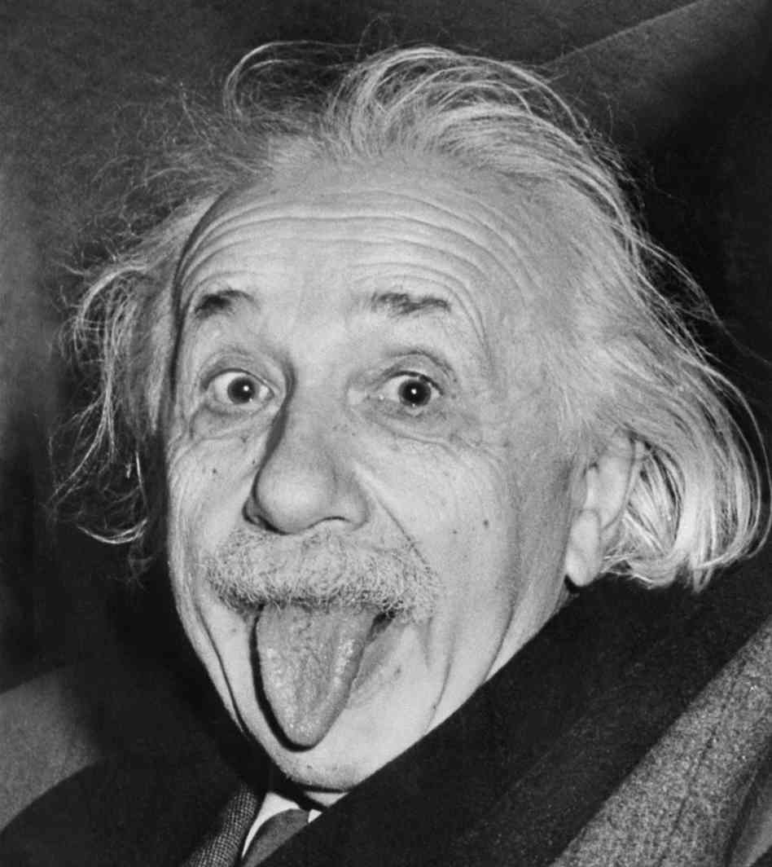
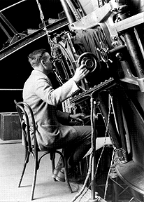
Dark Energy
68.3% of the total mass-energy of the known universe.
1916:
General Relativity:
Contracting Universe?
Einstein’s cosmological constant
1929:
Edwin Hubble:
Galaxies are receding?
Supports Friedman equations of general relativity. No cosmological constant.

Slide 20
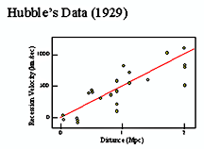
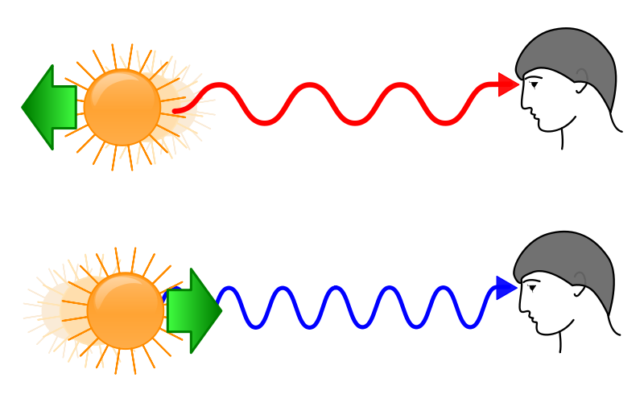
Space itself is expanding

Slide 21
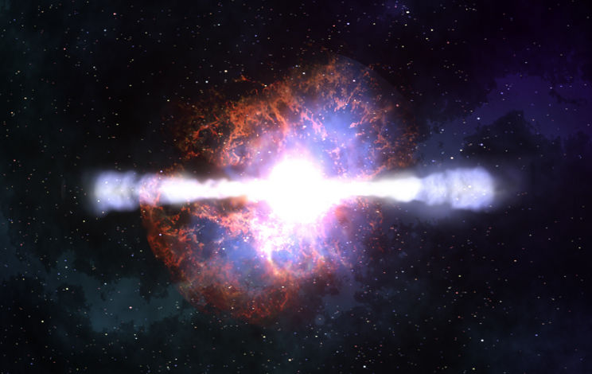
1998:
Observe very very distant supernovae:
Redshift was less in the past.
Universe is accelerating
Cosmological constant
Looking far away = Looking back in time
Type 1a Supernovae
Match observed data to predicted data based on Hubble’s Law.
What is causing this acceleration?

Slide 22
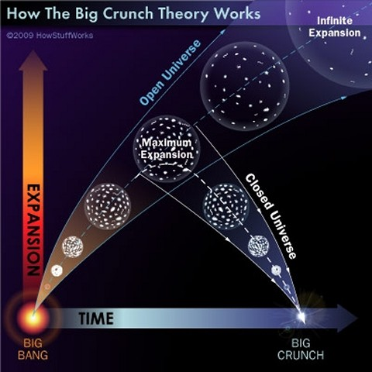
Is the universe open, closed, or cyclic?
Cosmological Constant or Quintessence?
Cosmic Coincidence?
Why did acceleration start when it did?
We know nothing

